Slide 1




Java Advanced
Course Introduction
Java
Advanced
SoftUni Team
Technical Trainers
Software University
http://softuni.bg

Slide 2
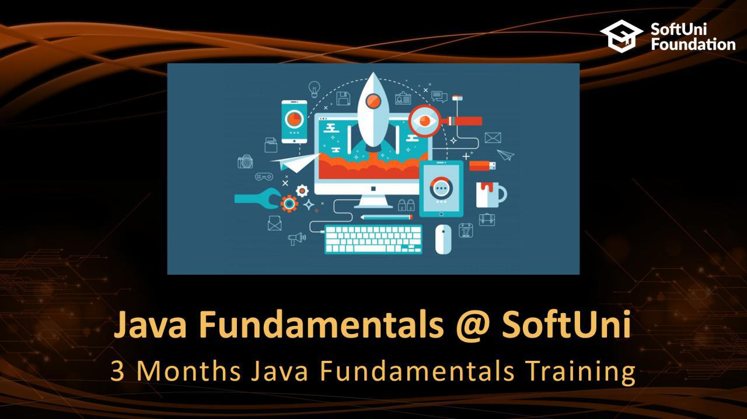

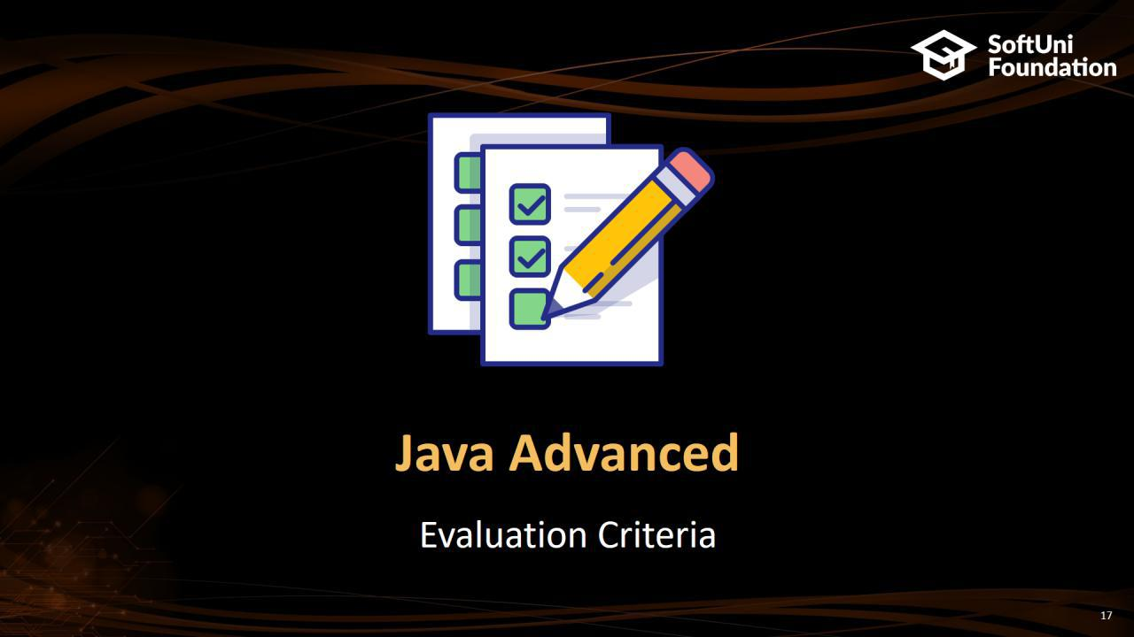
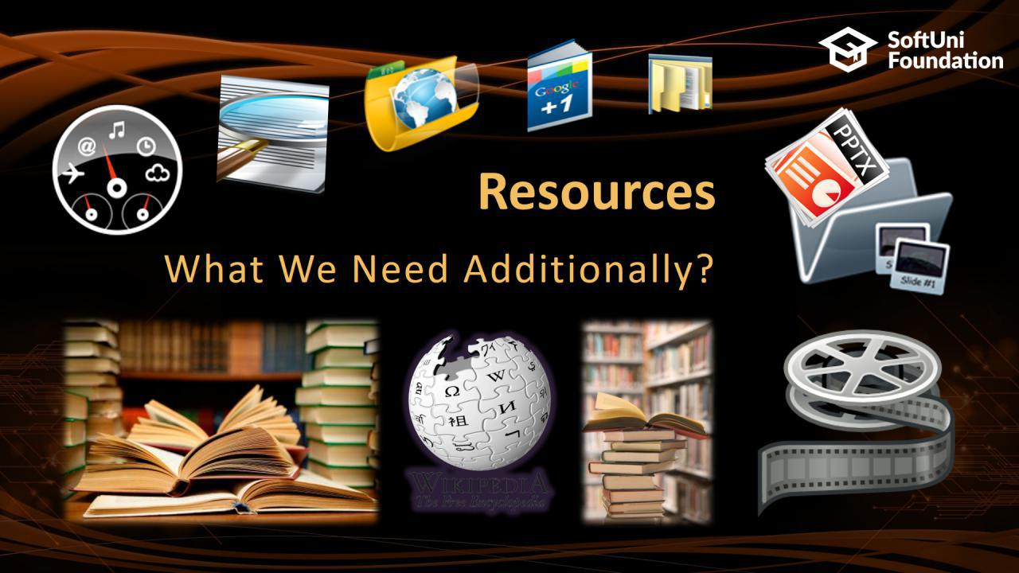
Table of Contents

Slide 3






SoftUni Diamond Partners

Slide 4






SoftUni Diamond Partners

Slide 5
Questions
sli.do #java-fund

Slide 6

Java Fundamentals @ SoftUni
3 Months Java Fundamentals Training

Slide 7
Java Fundamentals Module: Goals
„Java Fundamentals“ Module @ SoftUni
4 times weekly, lots of live coding and exercises
Part I – Java Advanced
Arrays, Matrices, Stacks and Queues, Sets and Maps, String, Functions and Lambda Expressions, Stream-API
Part II – Java OOP Basics
Defining Classes, Encapsulation, Inheritance, Polymorphism, Interfaces and Abstraction
Part III – Java OOP Advanced
Generics, Iterators and Comparators, Enums and Annotations, Reflection, Unit Testing, Dependency Inversion

Slide 8
Java Advanced Module at SoftUni – Timeline
14-May-2018
11-June-2018
9-July-2018
Java
Advanced
6 credits
4 weeks x 4 times / week
Final exam: 10-June-2018
Java OOP
Basics
9 credits
4 weeks x 4 times / week
Final exam: 8-July-2018
Java OOP
Advanced
12 credits
5 weeks x 4 times / week
Final exam: 12-August-2018

Slide 9

Java Advanced
Course Objectives & Program

Slide 10
Course Objective
Java is Everywhere
Wonderful Community Support
Java is Platform Independent
Excellent documentation support - Javadocs
Java is FREE
Great collection of Open Source libraries
Java has Rich API

Slide 11
Java Advanced – Course Program
Course Introduction – Course Program, Trainers, Exams, Resources
Java Intro – Basic Syntax
Linear Data Structures – Arrays, Matrices, Stacks and Queues
Sets and Maps – Overview and basic operations. Different implementations
Files and Directories – File open, File write, File close - texts
String Processing

Slide 12
Java Advanced – Course Program (2)
Functional Programming – Functions, Function types (delegates, predicates, consumers), Lambda code formatting
Build-In Query Methods – Stream API – Introducing Stream API - advanced Stream methods (grouping, flatMap, ...)
Exam Preparation – Solving practical exam problems – 2 Times
Practical Exam – 4 Problems for 6 Hours

Slide 13

The Trainers Team

Slide 14
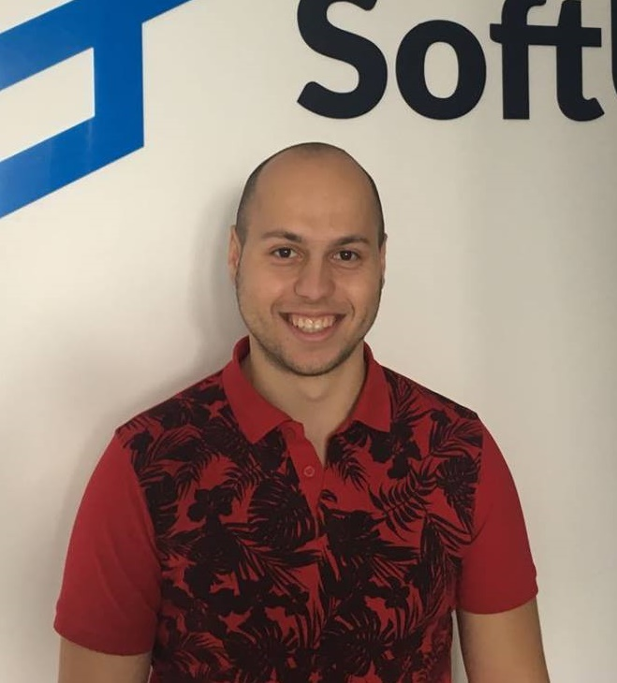
Ivo Hristov
Developer @ Musala Soft.
Experienced Technical Trainer
Passionate about Java Development
Top performing student @ SoftUni

Slide 15
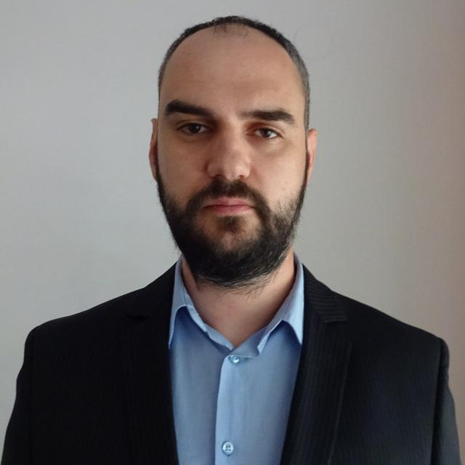
Hristo Skipernov
Developer @ Glitch Ltd
Experienced Technical Trainer
Interested in Java and JavaScript
Top performing student @ SoftUni

Slide 16

Training Duration – Java Advanced
Lessons: ~30 hours (onsite + videos)
Practical exercises (in class): ~40 hours
Exam preparation: 2*4 hours
Exam: 6 hours
Schedule: May –June 2018
Exam date: 11 June 2018

Slide 17



Learn to Search in Internet
The course assignments require to search in Internet
This is an important part of the learning process
Some exercises intentionally have no hints
Learn to find solutions!
Software development includes everyday searching and learning
No excuses, just learn to study!
Developers learn new technologies, tools, languages every day!

Slide 18

Java Advanced
Evaluation Criteria

Slide 19


Scoring System for “Java Advanced”
Exam – 85%
Homework (exercises) – 15%
Bonuses: up to 10%
Presence in class: 5% (onsite students only)
Forum activities: 5%

Slide 20

Homework Assignments
Doing your homework is very important!
Programming can only be learned through a lot of practice!
You should write code every day!
Each lesson is followed by many exercises
Try to solve them in class
The rest are your homework
Homework assignments are due in 6 days after each lecture
Submission through our online judge system: judge.softuni.bg

Slide 21
Java Advanced Exam
Practical programming exam
4 practical problems for 6 hours
Code in Java
Automated judge system
http://judge.softuni.bg
Solutions are evaluated for correctness only
Code quality is still not measured

Slide 22










Resources
What We Need Additionally?

Slide 23


Your RFID Chip
Students can either
Take RFID chip from SoftUni
Or use their own chip / card
Register your chip number in your SoftUni profile: https://softuni.bg/users/profile/show
Check-in at the reception every time when you come
See your last visits in your profile: https://softuni.bg/users/profile/show

Slide 24



JF Course Web Site, Forum and FB Group
Official web site:
Official discussion forum:
Official Facebook group:
softuni.bg/trainings/1975/java-advanced-may-2018
softuni.bg/forum/categories/7/java-advanced
fb.com/groups/SoftUniJavaFundamentalsMay2018/

Slide 25
The Java Fundamentals Slides and Videos
All lecture slides, videos, homework assignments, projects and other resources are open content, available for free
Visit the course web site to access the course resources

Slide 26

Book “Introduction to Programming with Java”
Book Introprogramming
” Introduction to Programming with Java ”, Svetlin Nakov and Co., 2015, ISBN 9789544005276
in PDF, HTML, ePub, Kindle
Free download: introprogramming.info

Slide 27

Software University Learning System (SULS)
Software University Learning System (SULS)
www.softuni.bg
Important resource for students
Homework submissions
Homework check-up
Exams and results
Reports about your progress

Slide 28


Required Software
Software needed for this course:
Microsoft Windows (Win 10 / Win 8.1 / Win8 / Win7)
IntelliJ IDEA 2017 Community (for Mac, Linux и Windows)
Alternative: Eclipse (for Mac, Linux и Windows)

Slide 29

Summary
Training program
Linear Data Structures, Sets and Maps, Files and Directories, String Processing, Functional Programming, Stream API
Practical exam
4 problems for 6 hours
Learning resources
Slides, videos, software, books, forum

Slide 30








Java Advanced – Course Overview
https://softuni.bg/courses/programming-fundamentals

Slide 31
License
This course (slides, examples, demos, videos, homework, etc.) is licensed under the "Creative Commons Attribution-NonCommercial-ShareAlike 4.0 International" license

Slide 32





Trainings @ Software University (SoftUni)
Software University – High-Quality Education, Profession and Job for Software Developers
softuni.bg
Software University Foundation
http://softuni.foundation/
Software University @ Facebook
facebook.com/SoftwareUniversity
Software University Forums
forum.softuni.bg

